Slide 1
Predicting The Next Recession
Stefan Kaehler

Slide 2
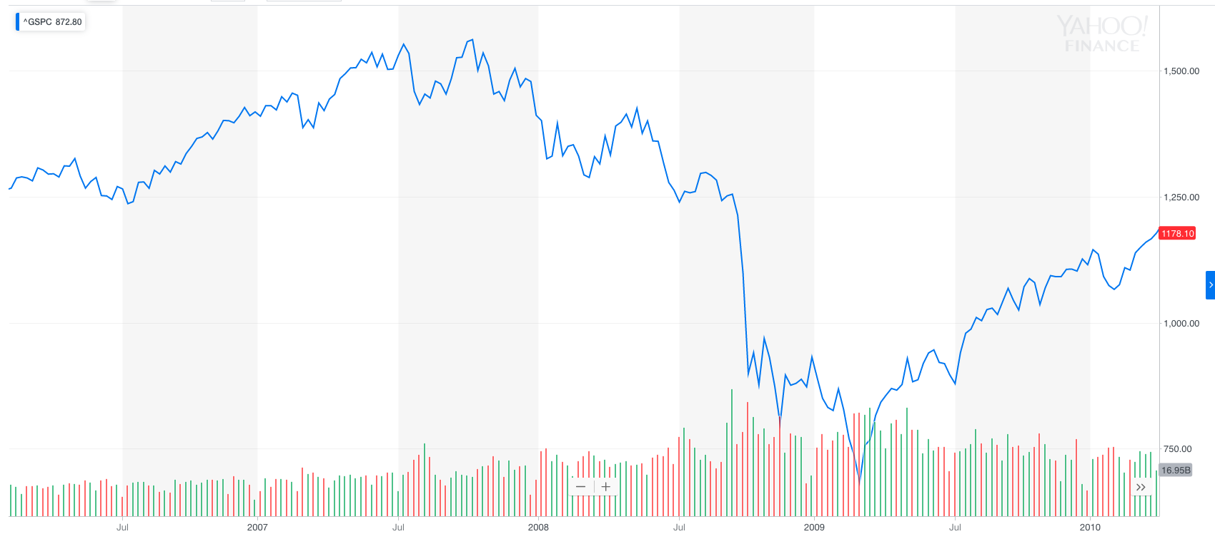
The Problem
Panic!

Slide 3
Methodology
20 Data Series
1960
March, 2019
Train
Test
November, 2004

Slide 4
Model Evaluation
 | Time Horizon | AUC | Log Loss
Random Forest | 0 | 0.899329 | 0.257567
 | -1 | 0.869687 | 0.286692
 | -3 | 0.88143 | 0.3244
 | -12 | 0.656879 | 0.412051
Gradient Boosted | 0 | 0.878076 | 0.266901
 | -1 | 0.842562 | 0.293302
 | -3 | 0.872483 | 0.306881
 | -12 | 0.72693 | 0.393345
Logistic Regression | 0 | 0.785794 | 0.319231
 | -1 | 0.816555 | 0.308765
 | -3 | 0.858501 | 0.395574
 | -12 | 0.684564 | 0.672108

Slide 5
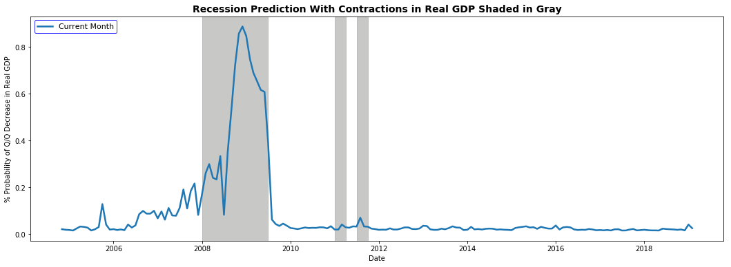
Model Results
*Note the 12 month prediction was shifted forward by 12 months to show alignment with recessions

Slide 6
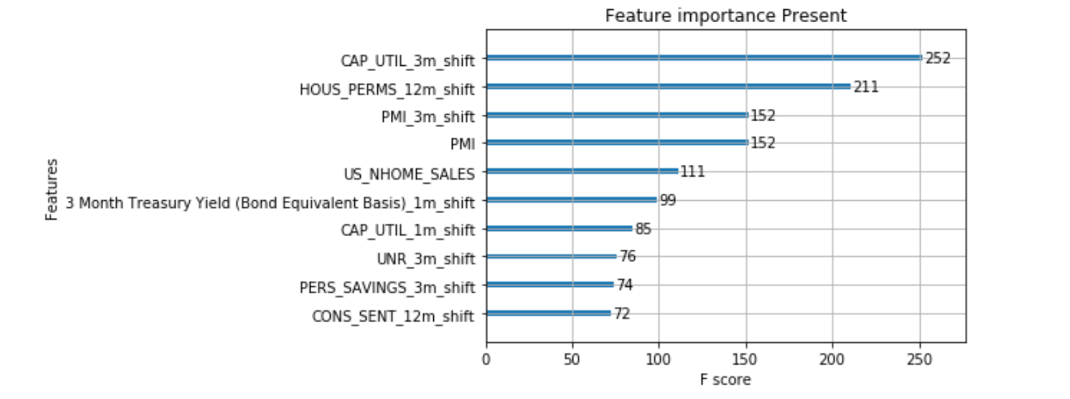
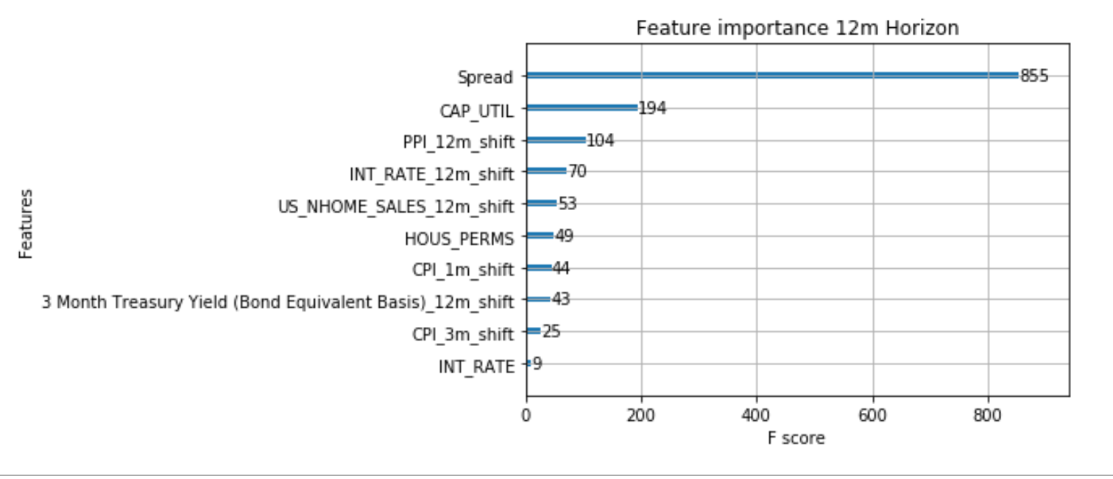
Feature Importance
Notes:
- Spread calculated off of the fed 10Y Yield – 3M yield

Slide 7
Next Steps

Slide 8
Questions

